Slide 1
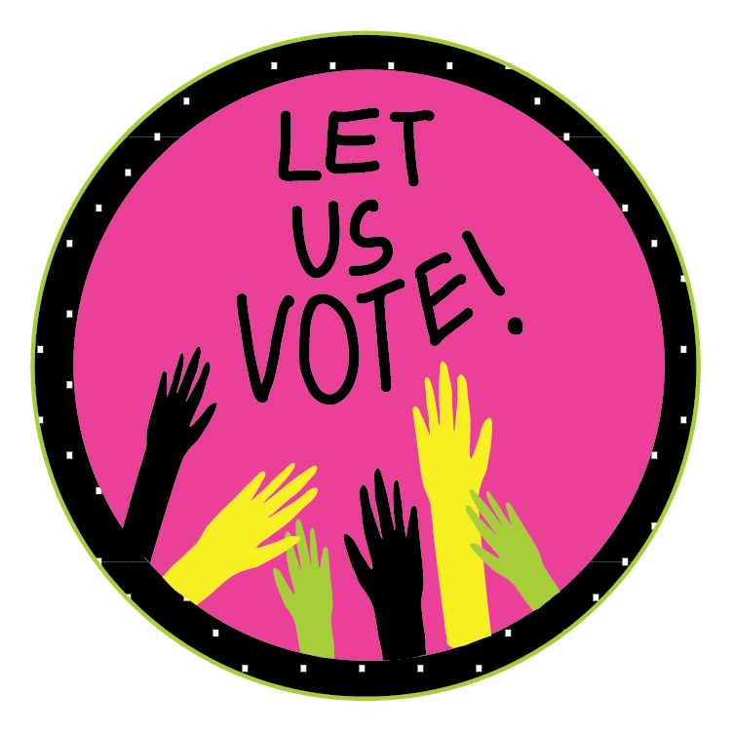
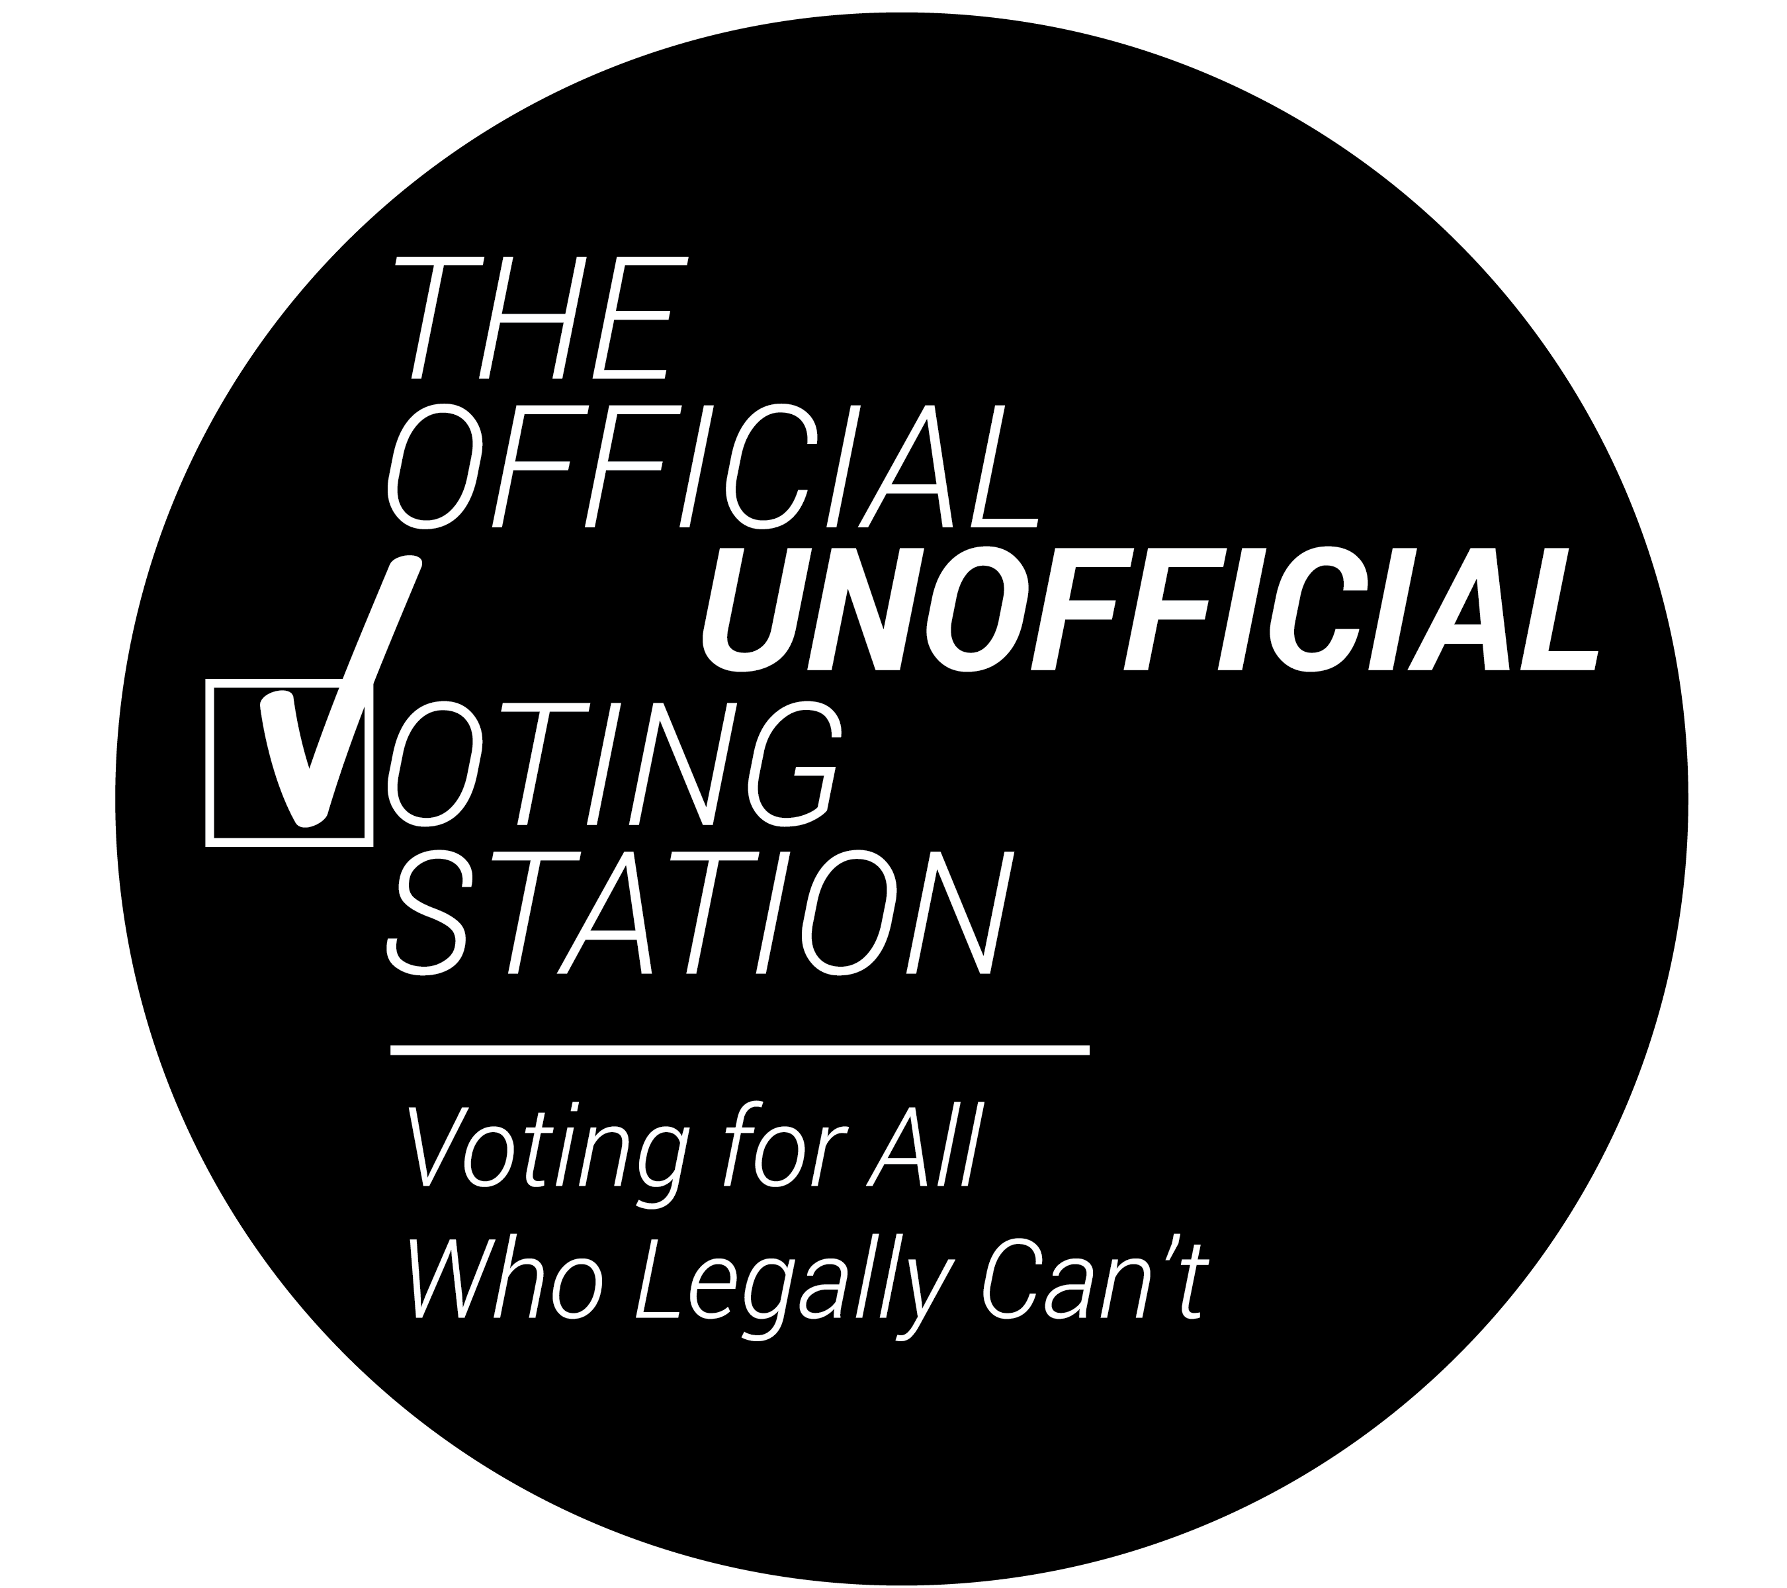
Who Can’t Legally Vote In the United States during the General Elections?

Slide 2
Disenfranchised (adjective)
____________________________________
Deprived of some right, privilege, or immunity.
Deprived of the right to vote.

Slide 3
Disenfranchised Populations:
Youth under 18 (2017 - 73.7 million)
Non- citizens (2018 – 22.6 million)
Including those who are undocumented (11 million)
Notes:
This list goes over who can’t legally vote in the United States. It goes from the largest group to the smallest.

Slide 4
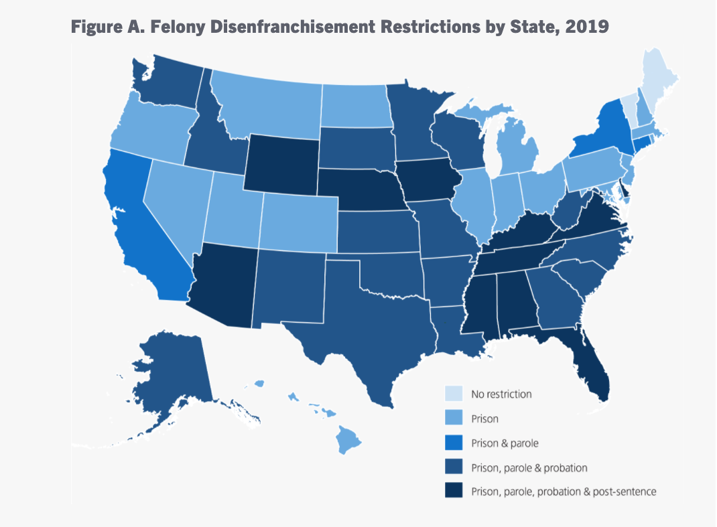
3. Incarcerated and Formerly Incarcerated (depending on state)
(5.2 million in 2020) estimated by the Sentencing Project
Notes:
As of 2020, 5.2 million Americans were prohibited from voting due to laws that disenfranchise citizens convicted of felony offenses. Felony disenfranchisement rates vary by state, as states institute a wide range of disenfranchisement policies – Sentencing project
In 2016 this number was at 6.1 million.
These laws depend state by state. If you live in a state, find your state. What is the law in your state?
For more information visit: https://www.sentencingproject.org/publications/felony-disenfranchisement-a-primer/

Slide 5
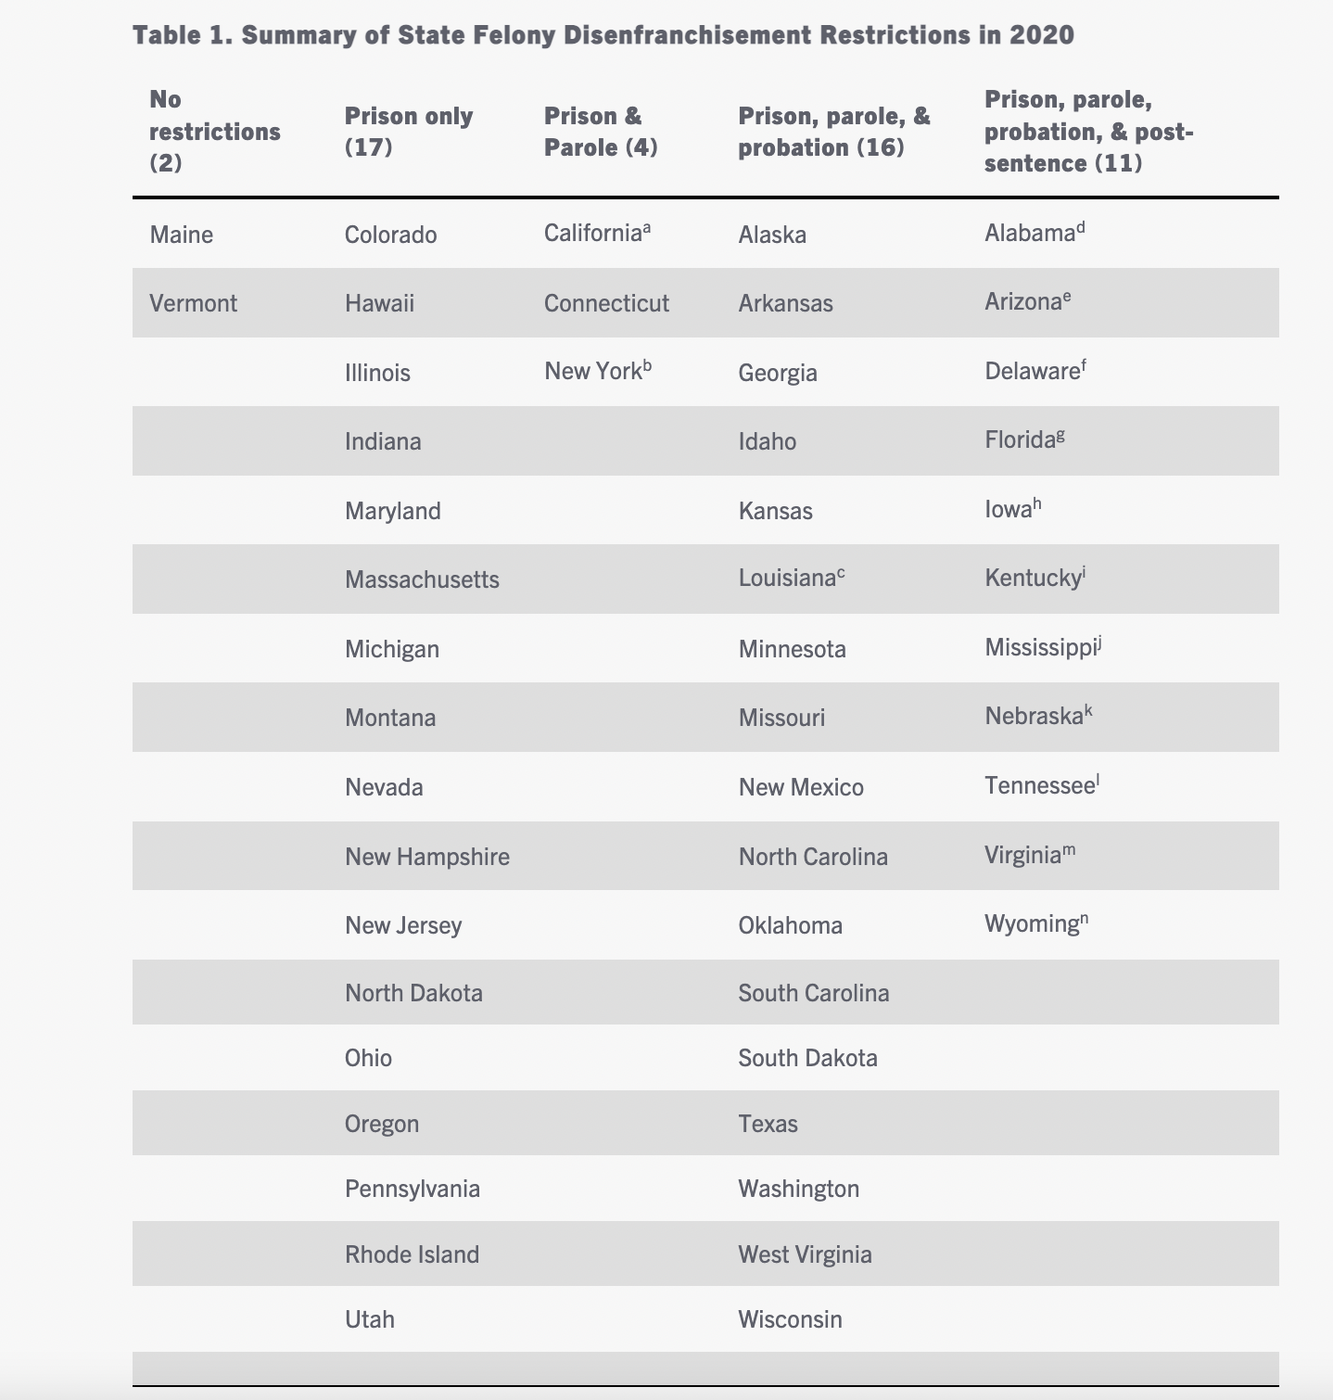
Sentencing Project
Notes:
In some states, such as Maine and Vermont, incarcerated people can vote via mail.
In 17 states, incarcerated people lose their right to vote when in prison. Once they are out, they regain their right to vote.
In 4 states, people cannot legally vote if in prison or on parole but regain their rights afterwards.
In 16 states, one must finish prison, parole and probation to regain voting rights.
And in 11 states, the laws are much stricter. In some states you lose your right to vote forever.
For example, in Kentucky the governor is the only one who can restore voting rights. The ex-offender must complete an application. It is up to the governor to accept or deny the application.
“Anyone convicted of a felony in Virginia automatically loses their civil rights - the right to vote, serve on a jury, run for office, become a notary public and carry a firearm. The Constitution of Virginia gives the Governor the sole discretion to restore civil rights, not including firearm rights.” - https://www.restore.virginia.gov/frequently-asked-questions/

Slide 6
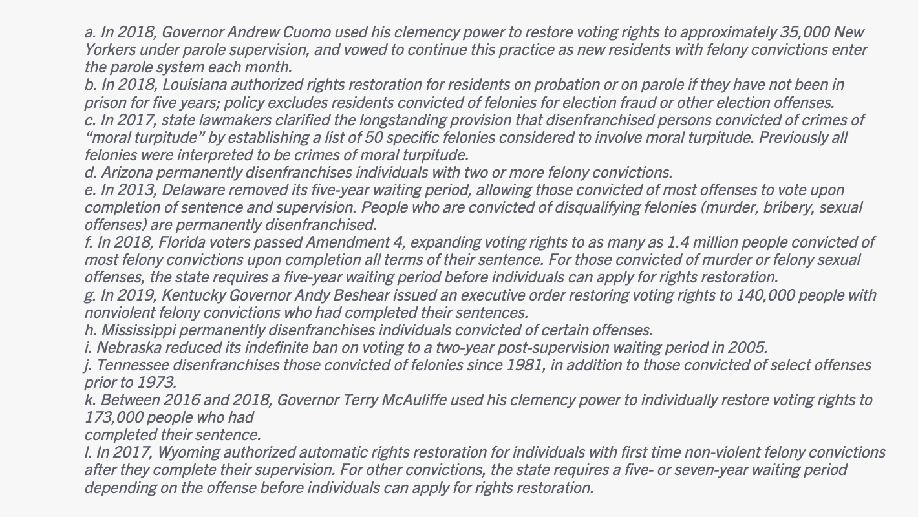
Sentencing Project
Notes:
*optional slide*
These are some specifics around select states and recent laws and actions that took place regarding voting rights for incarcerated and formerly incarcerated people.
As you can see, Governors are the only ones who can restore voting rights in some states. Depending on your state, you can call your governor and demand that they restore voting rights to incarcerated and formerly incarcerated people.
*Note: Go to previous slide if you’d like to see what state each of these notes apply to.*

Slide 7
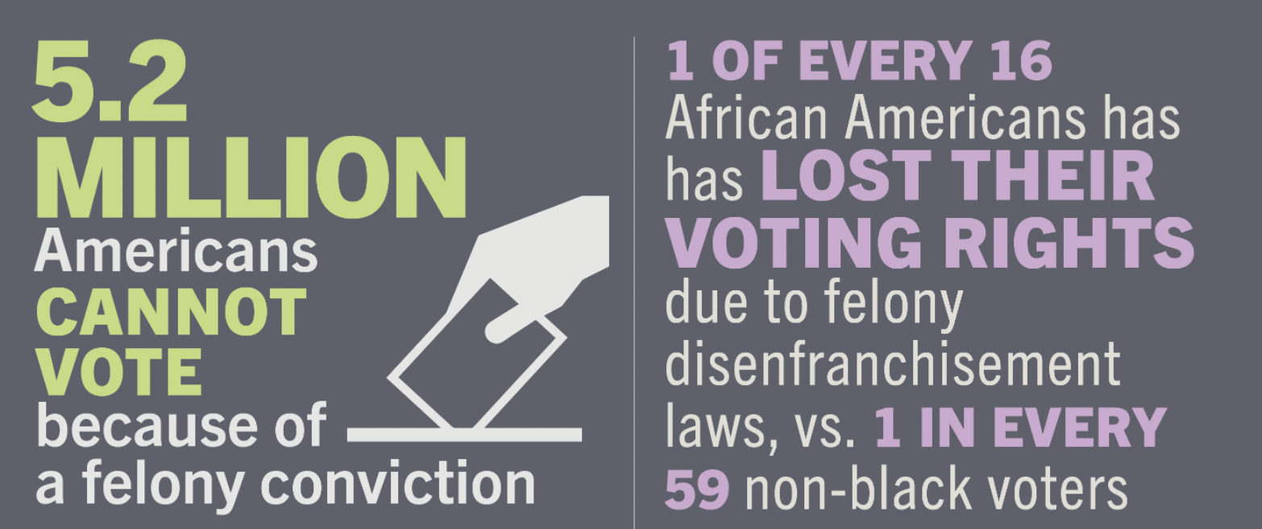
Felony disenfranchisement policies disproportionately impact communities of color, particularly black and brown communities.
________________________________________

Slide 8
4. For President: Residents of US Territories
Puerto Rico 3.194 million (2019)
Guam 165,768 (2018)
Northern Mariana Islands 56,882 (2018)
US Virgin Islands 106,977 (2018)
American Samoa 55,465 (2018)
Notes:
The fourth largest disenfranchised community are residents of U.S. territories.
People born in Guam, the Virgin Islands, the Northern Mariana Islands, American Samoa, and Puerto Rico are all Americans. They vote in US congressional elections and presidential primaries. But Americans born in these territories can't vote for president. Not unless they move to the mainland, except for American Samoans who are not U.S. Citizens. (They are only considered U.S. nationals).

Slide 9
Residents of U.S. Territories can vote in the primaries. ____________________________________
Residents of U.S. Territories cannot vote in the Presidential Elections.
____________________________________
They have non-voting members in the House of Representatives and no senate representation.

Slide 10
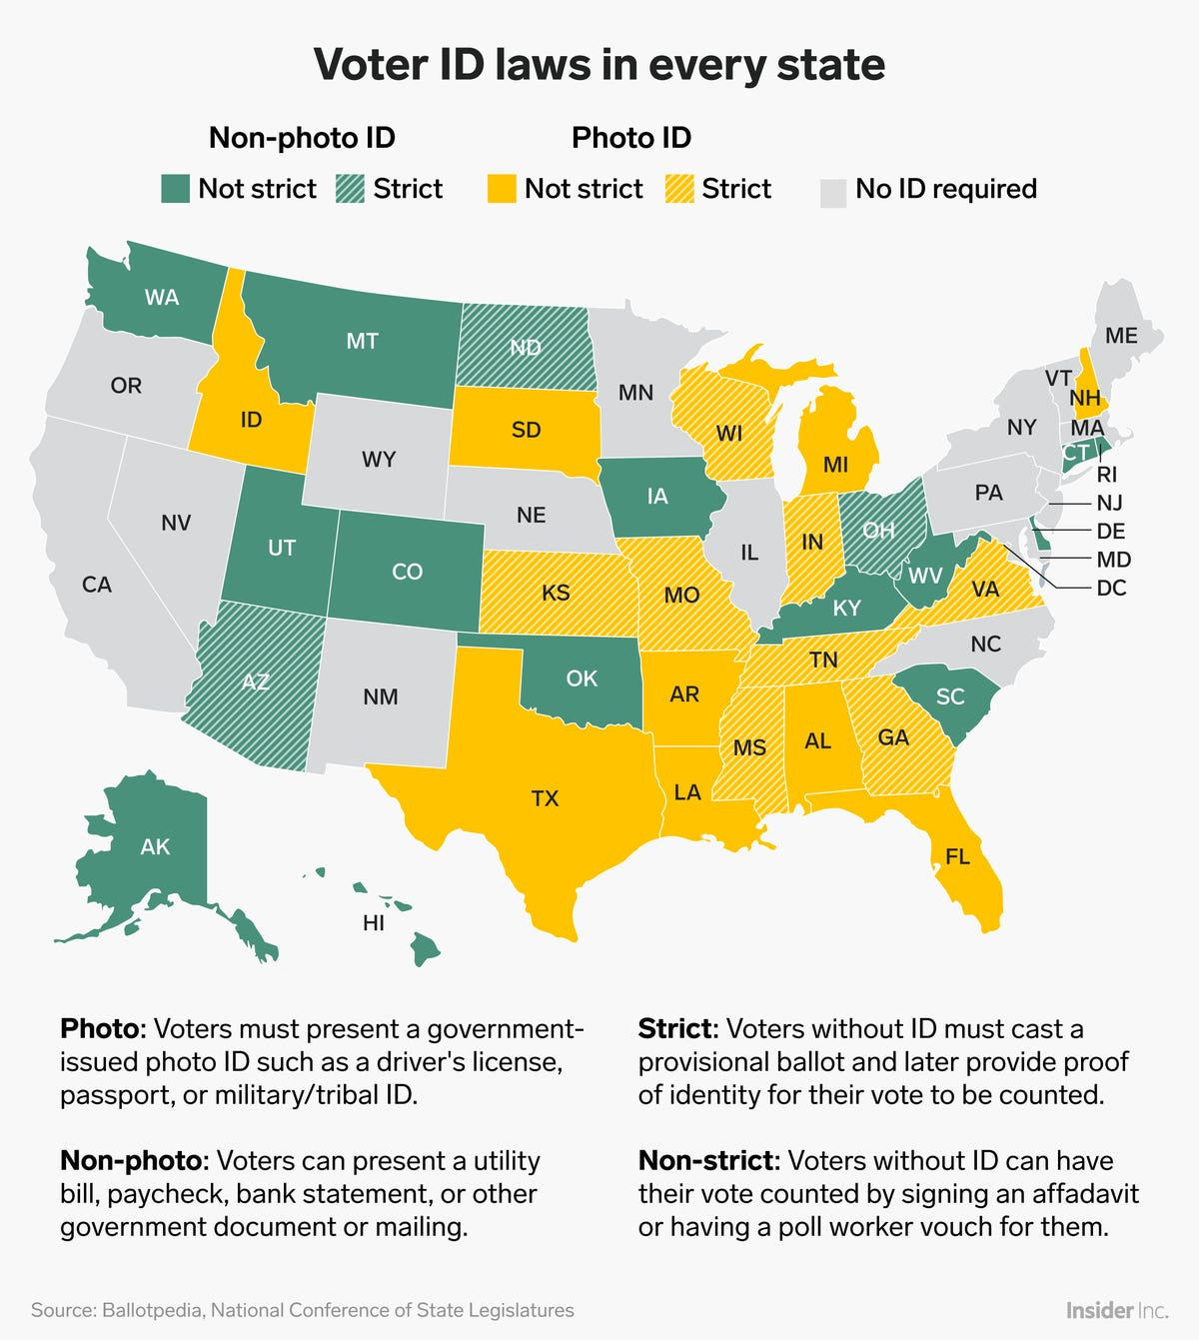
5. Those without specific ID (depending on state)
In 2018, Graphic by Insider, Inc.

Slide 11
6. As of 2016, the constitutions of 9 states still automatically ban anyone declared mentally incompetent – which includes anyone under guardianship -- from voting. These states are Alabama, Louisiana, Massachusetts, Minnesota, Missouri, South Carolina, South Dakota, Utah and Virginia, with some exceptions..

Slide 12
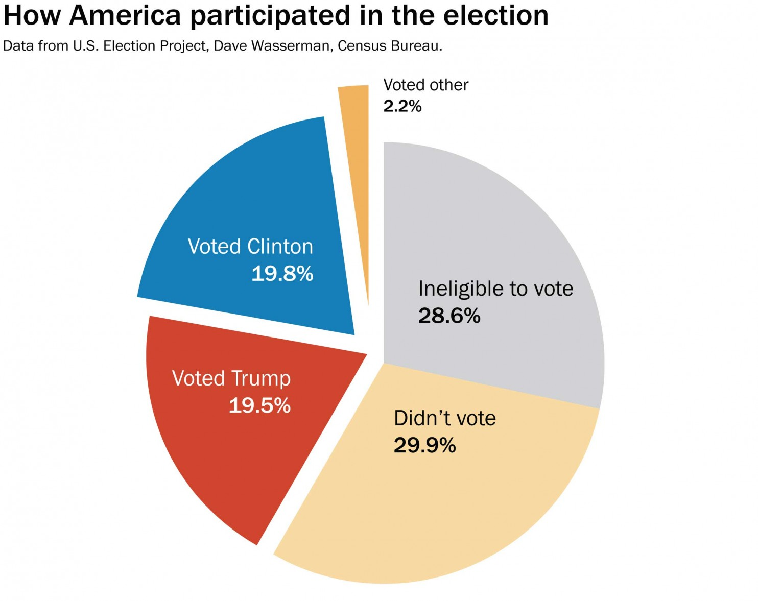
Data from the U.S. Election Project, 2016
Notes:
This Data from the US Election Project estimated that 28.6% of the population was ineligible to vote in 2016. That is approximately 92 million people! In 2020, it is estimated that approximately 90 million people were ineligible to vote.
We don’t have an exact updated number due to the constant changing of laws. Also, we don’t have data on the last two categories on the list: of people who can’t vote because they don’t have specific IDs and/or those deemed mentally incapacitated.
This list and percentage does not even address voter suppression!

Slide 13
Graphics by Cute Rage Press for the Official Unofficial Voting Station: Voting for All Who Legally Can’t, 2022

Slide 14
Questions for discussion:
________________________________________
Should the legal age to vote be lowered? If yes, to what age?
Should non-citizens have the right to vote?
Should all incarcerated people and formerly incarcerated people have the right to vote?
Should all residents of U.S. territories have the right to vote?
Should IDs be required to vote?
Should those deemed ”mentally incapacitated” have the right to vote?

Slide 15
_________________________________________
If we can reimagine voting and create our own rules, who should be able to vote? Who shouldn’t be able to vote? Why or why not?
_________________________________________

Slide 16
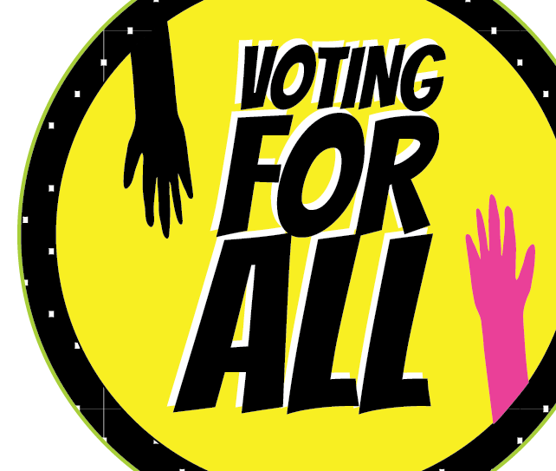
_________________
For virtual symbolic voting and more information, visit Officialunofficial.vote
_________________
Notes:
Visit Officialunofficial.vote for symbolic voting and more resources. There are fun things on the website including, but not limited to:
If We Could Vote, We Would! Wristbands by Undocumented Projects
snapchat and Instagram Voting Stickers for All filters by Cute Rage Press
Party as Protest Spotify playlist by Sadie Woods
Coloring sheets, word search, and crossword activity posters by William Estrada
And a list of Actions to Expand Voting Rights by Erin Delaney and Aram Han Sifuentes

